Slide 1
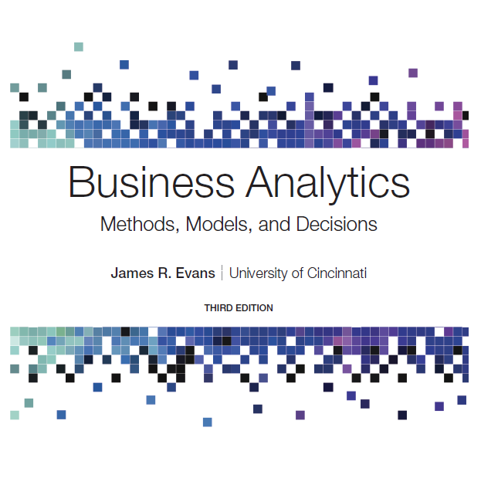
Business Analytics: Methods, Models, and Decisions
Third Edition
Chapter 13
Linear Optimization
Copyright © 2020, 2016, 2013 Pearson Education, Inc. All Rights Reserved
Notes:
If this PowerPoint presentation contains mathematical equations, you may need to check that your computer has the following installed:
1) MathType Plugin
2) Math Player (free versions available)
3) NVDA Reader (free versions available)

Slide 2
Optimization
Optimization is the process of selecting values of decision variables that minimize or maximize some quantity of interest.
Optimization models have wide applicability in operations and supply chains, finance, marketing, and other disciplines.

Slide 3
Linear Optimization Models
A linear optimization model (often called a linear program, or L P) has two basic properties.
The objective function and all constraints are linear functions of the decision variables.
This means that each function is simply a sum of terms, each of which is some constant multiplied by a decision variable.
All variables are continuous.
This means that they may assume any real value (typically, nonnegative).

Slide 4
Integer Linear Optimization Models
In an integer linear optimization model (also called an integer program, or I P model), some of or all the variables are restricted to being whole numbers.
A special type of integer problem is one in which variables can be only 0 or 1.
More difficult to solve, but have important applications in scheduling and supply chains.

Slide 5
Nonlinear Optimization Models
Whenever either the objective function or a constraint is not linear, we have a nonlinear optimization model (also called a nonlinear program, or N L P model).
The objective function and/or constraint functions are nonlinear functions of the decision variables.

Slide 6
Generic Examples of Linear Optimization Models (1 of 2)
Type of model | Decisions | Objective | Typical Constraints
Product mix | Quantities of product to produce and sell | Maximize contribution to profit | Resource limitations (for example, production time, labor, material); minimum sales requirements; maximum sales potential
Process selection | Quantities of product to make using alternative processes | Minimize cost | Demand requirements; resource limitations
Blending | Quantity of materials to mix to produce one unit of output | Minimize cost | Specifications on acceptable mixture
Portfolio selection | Proportions to invest in different financial instruments | Maximize future return or minimize risk exposure | Limit on available funds; sector requirements or restrictions; proportional relationships on investment mix

Slide 7
Generic Examples of Linear Optimization Models (2 of 2)
Type of model | Decisions | Objective | Typical Constraints
Transportation | Amount to ship between sources of supply and destinations | Minimize total transportation cost | Limited availability at sources; required demands met at destinations
Multiperiod production planning | Ouantities of product to produce in each of several time periods; amount of inventory to hold between periods | Minimize total production and inventory costs | Limited production rates; material balance equations
Multiperiod financial management | Amount to invest in short term instruments | Maximize cash on hand | Cash balance equations; required cash obligations
Production/Marketing | Allocations od advertising expenditures;production quantities | Maximize profit | Budget limitation; production Iimitations; demand requirements

Slide 8
Developing Linear Optimization Models
Identify the decision variables - the unknown values that the model seeks to determine.
Identify the objective function - the quantity we seek to minimize or maximize.
Identify all appropriate constraints - limitations, requirements, or other restrictions that are imposed on any solution, either from practical or technological considerations or by management policy.
Write the objective function and constraints as mathematical expressions.
Implement the mathematical model on a spreadsheet.

Slide 9
Example 13.1: Sklenka Ski Company: Identifying Model Components (1 of 4)
S S C sells two snow ski models - Jordanelle & Deercrest.
Manufacturing requires fabrication and finishing.
The fabrication department has 12 skilled workers, each of whom works 7 hours per day. The finishing department has 3 workers, who also work a 7-hour shift.
Each pair of Jordanelle skis requires 3.5 labor-hours in the fabricating department and 1 labor-hour in finishing.
The Deercrest model requires 4 labor-hours in fabricating and 1.5 labor-hours in finishing.
The company operates 5 days per week.
S S C makes a net profit of $50 on the Jordanelle model and $65 on the Deercrest model.

Slide 10
Example 13.1: Sklenka Ski Company: Identifying Model Components (2 of 4)
Step 1: Identify the decision variables.
The company wants to determine how many of each model should be produced on a daily basis to maximize net profit.
Define
Jordanelle = number of pairs of Jordanelle skis produced/day
Deercrest = number of pairs of Deercrest skis produced/day
Clearly specify the dimensions of the variables!

Slide 11
Example 13.1: Sklenka Ski Company: Identifying Model Components (3 of 4)
Step 2: Identify the objective function.
S S C wishes to maximize net profit, and we are given the net profit figures for each type of ski.
S S C makes a net profit of $50 on the Jordanelle model and $65 on the Deercrest model.

Slide 12
Example 13.1: Sklenka Ski Company: Identifying Model Components (4 of 4)
Step 3: Identify the constraints.
Look for clues in the problem statement that describe limited resources that are available, requirements that must be met, or other restrictions.
Both the fabrication and finishing departments have limited numbers of workers, who work only 7 hours each day; this limits the amount of production time available in each department:
Fabrication: Total labor hours used in fabrication cannot exceed the amount of labor hours available.
Finishing: Total labor hours used in finishing cannot exceed the amount of labor hours available.
The problem also notes that the company anticipates selling at least twice as many Deercrest models as Jordanelle models:
Number of pairs of Deercrest skis must be at least twice the number of parts of Jordanelle skis.
Negative values of the decision variables cannot occur (“nonnegativity constraints”).

Slide 13
Developing a Mathematical Model
Represent decision variables by descriptive names, abbreviations, or subscripted letters.
For mathematical formulations involving many variables, subscripted letters are often more convenient.
In spreadsheet models, we recommend using more descriptive names to make the models and solutions easier to understand.

Slide 14
Example 13.2: S S C - Modeling the Objective Function
Profit per pair of skis sold:$50 for Jordanelle skis, $65 for Deercrest skis
Objective Function: Maximize total profit= 50 Jordanelle + 65 Deercrest
Note how the dimensions verify that the expression is correct:

Slide 15
Translating Constraints Mathematically
Constraints are expressed as algebraic inequalities or equations, with all variables on the left side and constant terms on the right.
Look for key words in word statements of constraints:
“Cannot exceed” translates mathematically as
“At least,” would translate as
“Must contain exactly,” would specify an “= ” relationship.
All constraints in optimization models must be one of these three forms.

Slide 16
Constraint Functions
A constraint function is the left-hand side of a constraint.
E.g.: Total labor-hours used in fabrication cannot exceed the amount of labor hours available.

Slide 17
Example 13.3: S S C - Modeling the Constraints (1 of 2)
Fabrication constraint
Available fabrication labor hours:
Required fabrication labor hours per ski pair: 3.5 hours for Jordanelle, 4 hours for Deercrest
Fabrication constraint:
Finishing constraint
Available finishing labor hours:
Required finishing labor hours per ski pair: 1 hour for Jordanelle; 1.5 hours for Deercrest
Finishing constraint:

Slide 18
Example 13.3: S S C - Modeling the Constraints (2 of 2)
Market mixture constraint
The number of pairs of Deercrest skis must be at least twice the number of Jordanelle skis.
or
Nonnegativity constraints:

Slide 19
S S C Optimization Model
Maximize total profit = 50 Jordanelle + 65 Deercrest
The highlighted portions are the constraint functions.

Slide 20
Types of Constraints
Simple Bounds. Simple bounds constrain the value of a single variable.
Limitations. Limitations usually involve the allocation of scarce resources.
Requirements. Requirements involve the specification of minimum levels of performance.
Proportional Relationships. Proportional relationships are often found in problems involving mixtures or blends of materials or strategies.
Balance Constraints. Balance constraints essentially state that input = output.

Slide 21
Example 13.4: Modeling Constraints (1 of 5)
Simple bound: We must produce at least 350 units of product Y to meet customer commitments this month.
Amount of product Y ≥ 350
Define Product_Y to be the number of units of product Y produced. Then the constraint is

Slide 22
Example 13.4: Modeling Constraints (2 of 5)
Limitation: The amount of money spent on research and development projects cannot exceed the assigned budget of $300,000.
Amount spent on research and development ≤ $300,000
Define R&DExpenses to be the amount of money spent on research and development projects. Then the constraint is

Slide 23
Example 13.4: Modeling Constraints (3 of 5)
Requirement: Contractual requirements specify that a total of at least 500 units of product must be shipped from factories in Austin and Atlanta.
Number of units of product shipped from Austin and Atlanta ≥ 500
Define X1 = amount shipped from Austin and X2 = amount shipped from Atlanta. Then the constraint is X1 + X2 ≥ 500.

Slide 24
Example 13.4: Modeling Constraints (4 of 5)
Proportional relationship: A mixture of fertilizer must contain exactly 30% nitrogen.
Amount of nitrogen in mixture/total amount in mixture = 0.30
Suppose that two ingredients contain 20% and 33% nitrogen, respectively. Define x and y to be the number of pounds of the two ingredients in the mixture.
Amount of nitrogen in mixture =
Total amount of mixture = x + y
Fraction of nitrogen in mix =

Slide 25
Example 13.4: Modeling Constraints (5 of 5)
Balance constraint: Available inventory and production in June must satisfy the demand of 150 units or be held over to July.
Inventory and production in current month = demand and inventory held over to the next month
Define I_June = inventory available in June, I_July = inventory held over to July, and P_June = production in June.
Then the constraint is I_June + P_June = 150 + I_July.

Slide 26
Implementing Linear Optimization Models on Spreadsheets
Put the objective function coefficients, constraint coefficients, and right-hand values in a logical format in the spreadsheet.
For example, you might assign the decision variables to columns and the constraints to rows.
Define a set of cells (either rows or columns) for the values of the decision variables.
The names of the decision variables should be listed directly above the decision variable cells.
Use shading or other formatting to distinguish these cells.
Define separate cells for the objective function and each constraint function (the left-hand side of a constraint).
Use descriptive labels directly above these cells.

Slide 27
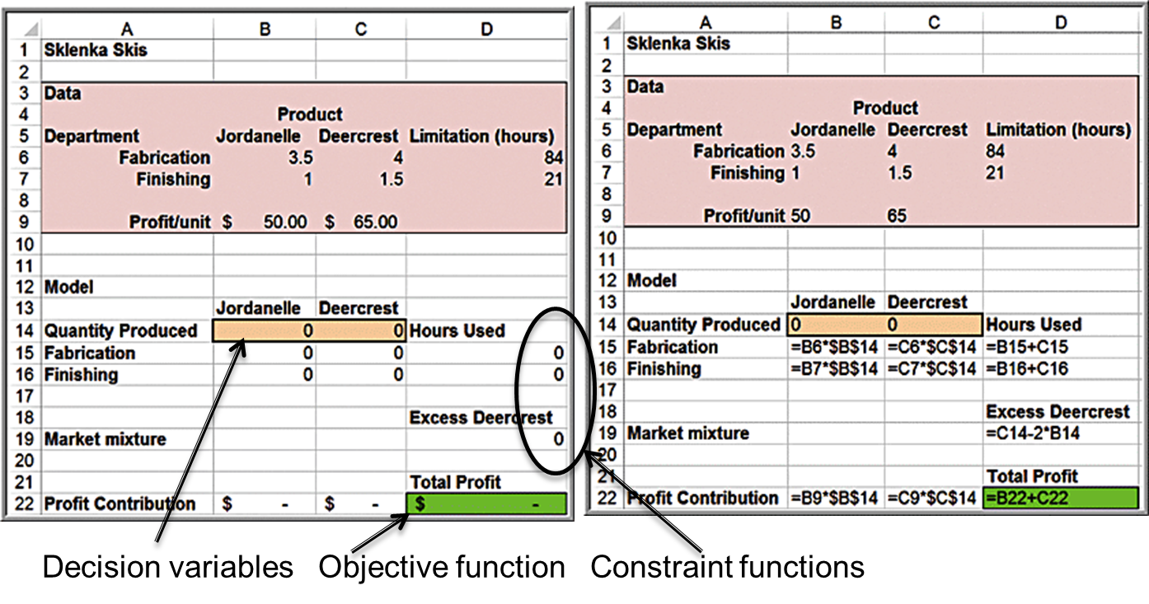
Example 13.5: A Spreadsheet Model for Sklenka Skis

Slide 28
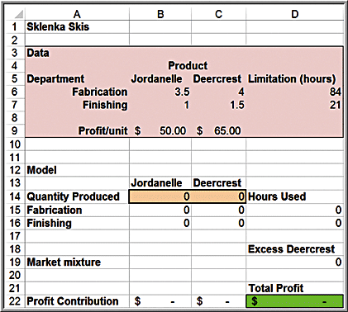
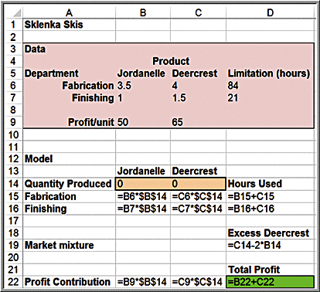
Correspondence Between the Model and the Spreadsheet
Maximize 50 Jordanelle + 65 Deercrest

Slide 29
Using the SUMPRODUCT Function
In Excel, the pairwise sum of products of terms can easily be computed using the SUMPRODUCT function.
This often simplifies the model-building process, particularly when many variables are involved.

Slide 30
Excel Functions to Avoid in Linear Optimization
Several common functions in Excel can cause difficulties when attempting to solve linear programs using Solver because they are discontinuous (or “nonsmooth”) and do not satisfy the conditions of a linear model.
These include:
ABS
IF
MIN and MAX
INT
ROUND
COUNT

Slide 31
Solving Linear Optimization Models
A feasible solution to an optimization problem is any solution that satisfies all of the constraints.
An optimal solution is the best of all the feasible solutions.
Software for determining optimal solutions
Solver (“standard Solver”) is a free add-in packaged with Excel for solving optimization problems.
Use the Solver Parameters dialog to define the objective, decision variables, and constraints from your spreadsheet model.

Slide 32
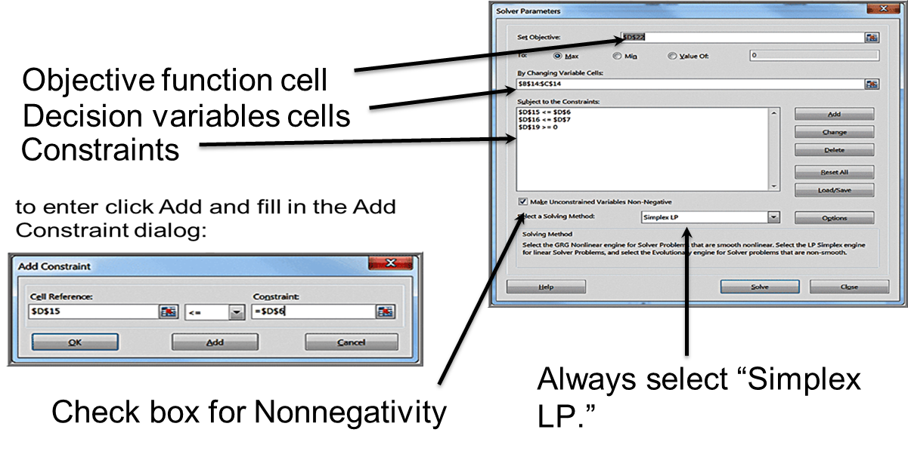
Example 13.6: Using Standard Solver for the S S C Problem
Solver Parameters dialog

Slide 33
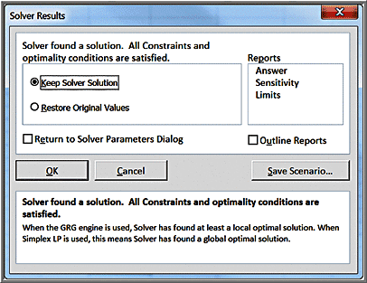
Solver Results Dialog
Three reports: Answer, Sensitivity, and Limits
To add them to your Excel workbook, click on the ones you want and then click O K.
Do not check the box Outline Reports; this is an Excel feature that produces the reports in “outlined format.”

Slide 34
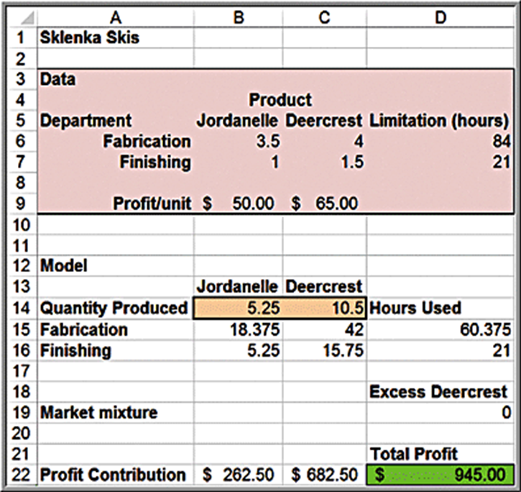
Optimal Solution to S S C Problem

Slide 35
Solver Answer Report
The Solver Answer Report provides basic information about the solution, including the values of the original and optimal objective function (in the Objective Cell section) and decision variables (in the Decision Variable Cells section).
In the Constraints section, Cell Value refers to the value of the constraint function using the optimal values of the decision variables.
A binding constraint is one for which the Cell Value is equal to the right-hand side of the value of the constraint.
The Status column tells whether each constraint is binding or not binding.
Slack refers to the difference between the left- and right-hand sides of the constraints for the optimal solution.

Slide 36
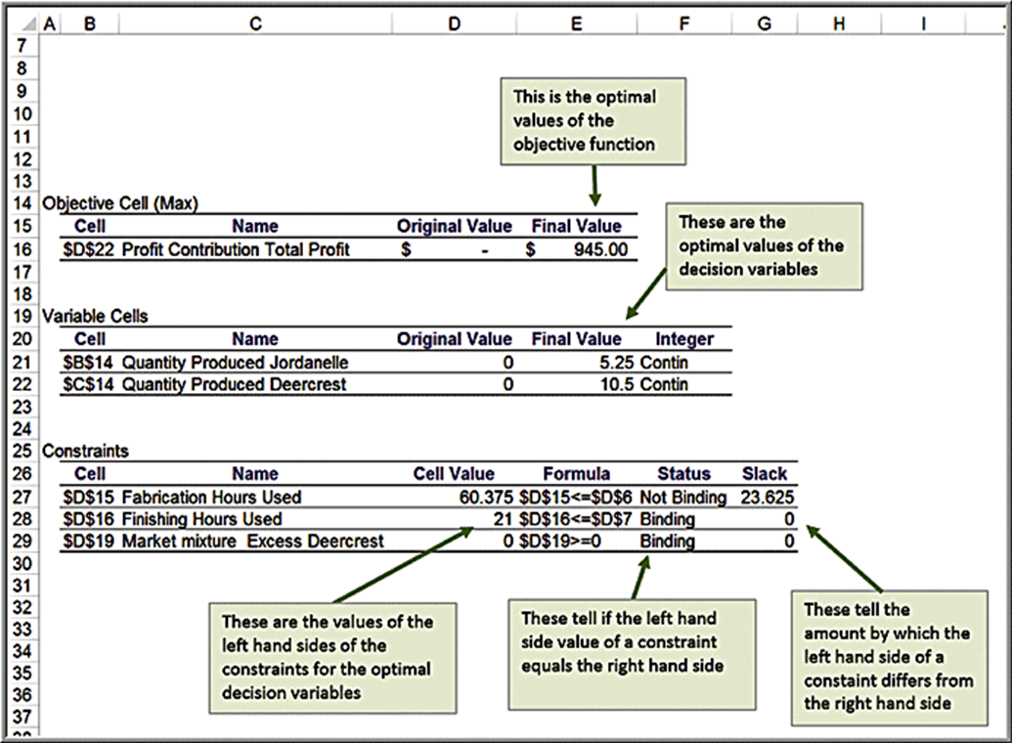
Example 13.7: Interpreting the S S C Answer Report (1 of 2)

Slide 37
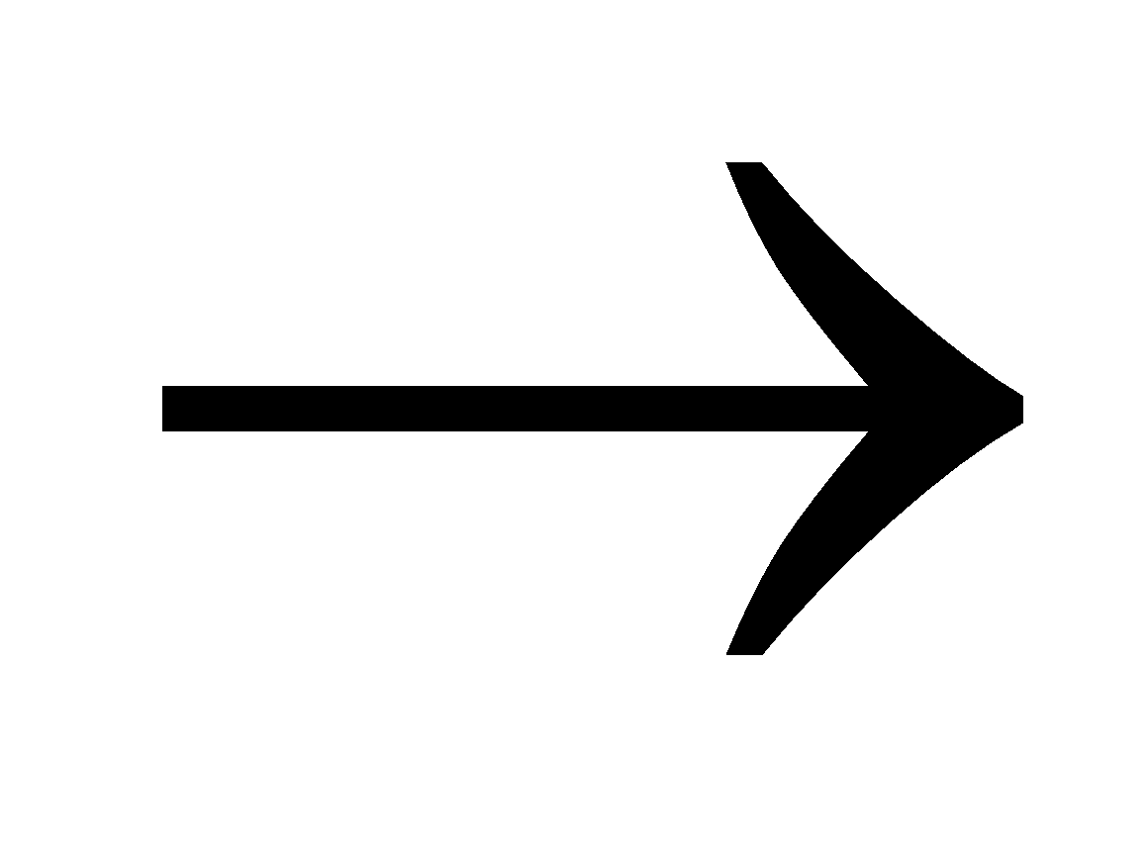
Example 13.7: Interpreting the S S C Answer Report (2 of 2)
Understanding slack values
Optimal solution: Jordanelle = 5.25; Deercrest = 10.5
Fabrication constraint:
23.625 excess fabrication hours
Finishing constraint:
No excess finishing hours
Market mix constraint:
Exactly twice the number of Deercrest skis as Jordanelle skis

Slide 38
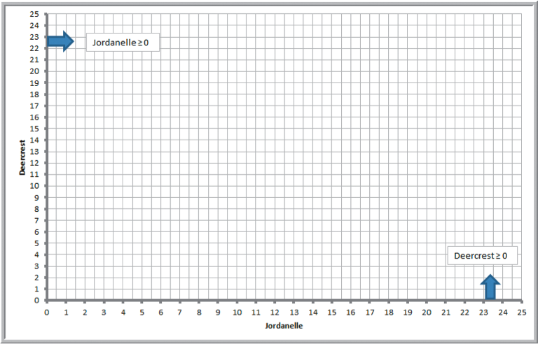
Graphical Interpretation of Linear Optimization
The set of feasible solutions is called the feasible region.
For a problem with only two decision variables,
we can draw the
feasible region on a two-dimensional coordinate system by plotting the equations corresponding to each constraint.
Nonnegativity constraints:

Slide 39
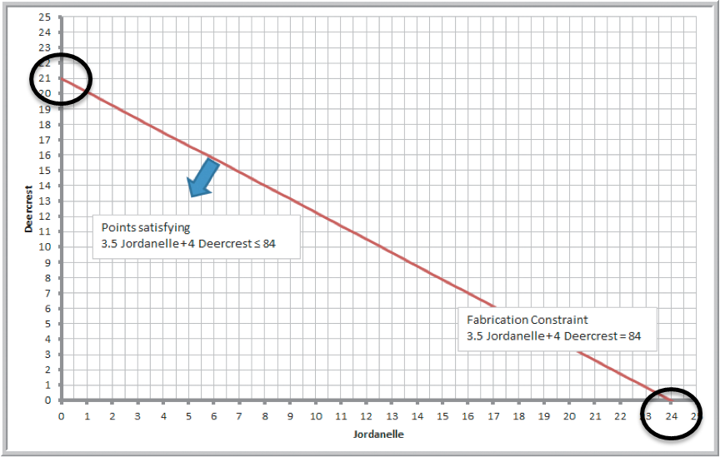
Example 13.8: Graphing the Constraints in the S S C Problem (1 of 3)
Fabrication constraint:
Plot the equation: 3.5 Jordanelle + 4 Deercrest = 84
Set Jordanelle = 0; Deercrest = 21
Set Deercrest = 0; Jordanelle = 24

Slide 40
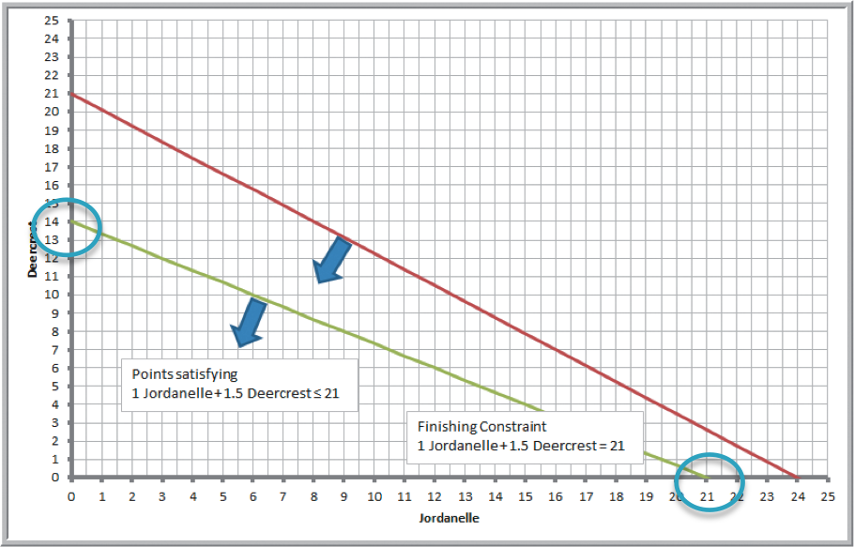
Example 13.8: Graphing the Constraints in the S S C Problem (2 of 3)
Finishing constraint:
Plot the equation: 1 Jordanelle + 1.5 Deercrest = 21
Set Jordanelle = 0; Deercrest = 14
Set Deercrest = 0; Jordanelle = 21

Slide 41
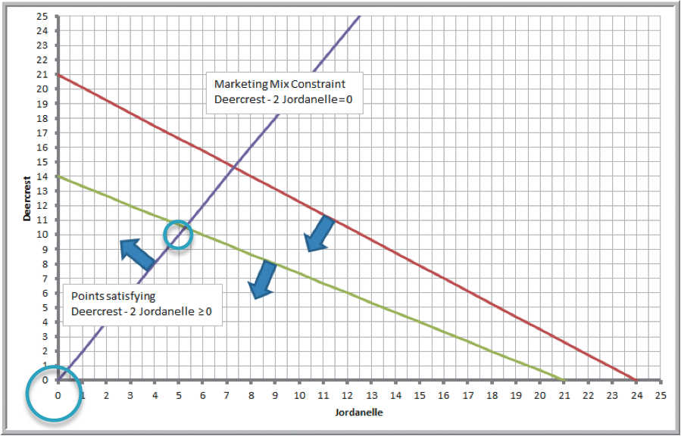
Example 13.8: Graphing the Constraints in the S S C Problem (3 of 3)
Market mix constraint:
Plot the equation: −2 Jordanelle + 1 Deercrest = 0
Set Jordanelle = 5; Deercrest = 10
Set Deercrest = 0; Jordanelle = 0

Slide 42
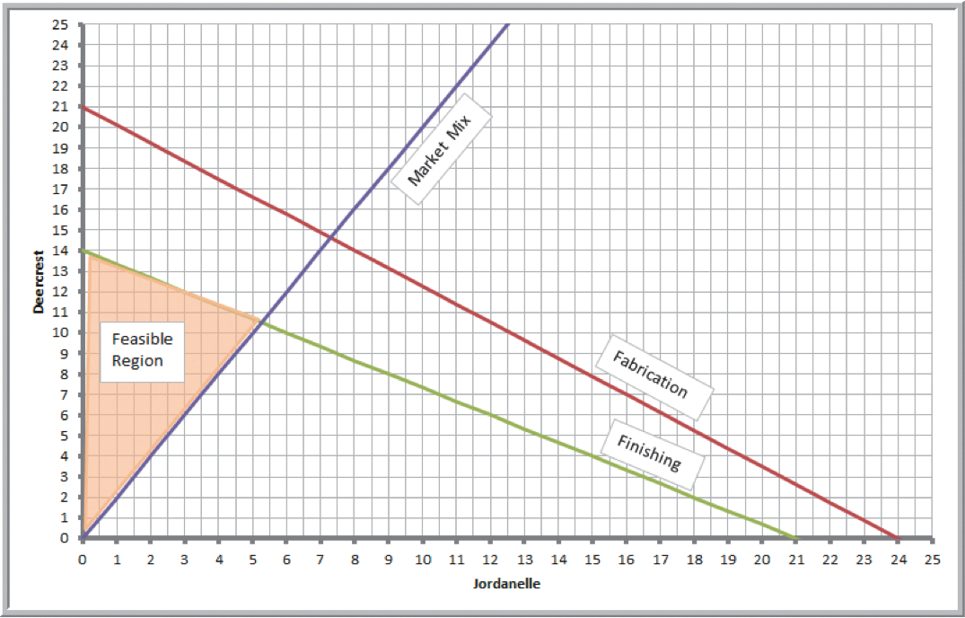
Example 13.9: Identifying the Feasible Region and Optimal Solution (1 of 2)
Feasible region

Slide 43
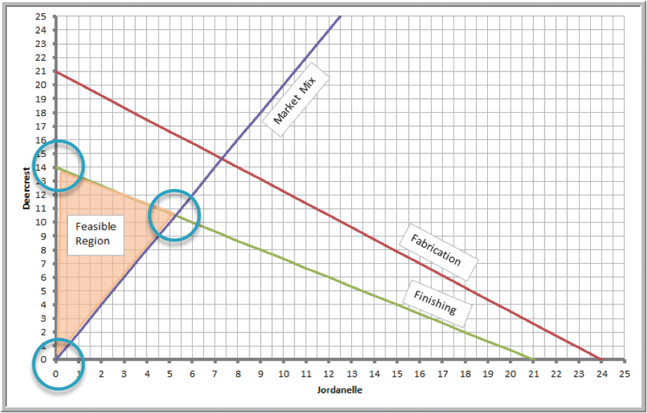
Corner Points
The points at which the constraint lines intersect along the feasible region are called corner points.
If an optimal solution exists, then it will occur at a corner point.

Slide 44
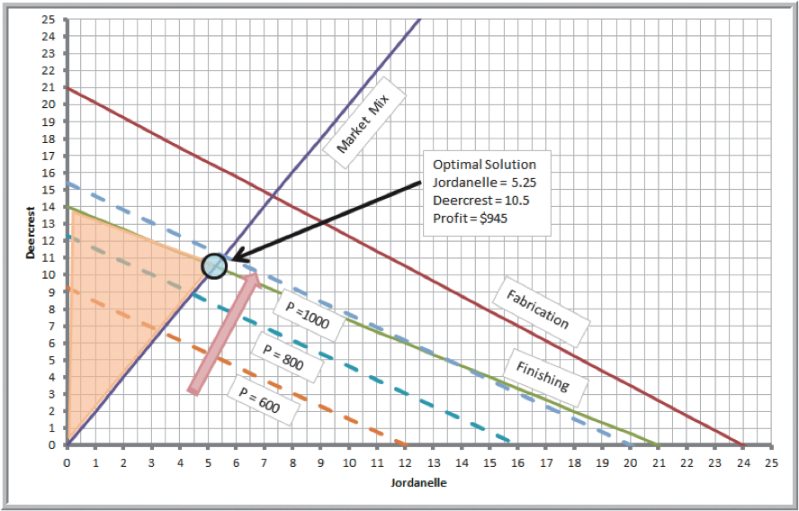
Example 13.9: Identifying the Feasible Region and Optimal Solution (2 of 2)
Because our objective is to maximize profit, we seek a corner point that has the largest value of the objective function Total Profit = 50 Jordanelle + 65 Deercrest.
Graph the profit line and move in an improving direction until it passes through the last corner point of the feasible region.
Solve the two intersecting equations simultaneously to find the optimal solution.

Slide 45
How Solver Works
Solver uses a mathematical algorithm called the simplex method, which was developed in 1947 by the late Dr. George Dantzig.
The simplex method characterizes feasible solutions algebraically by solving systems of linear equations.
It moves systematically from one corner point to another to improve the objective function until an optimal solution is found (or until the problem is deemed infeasible or unbounded).
It is quick and efficient.

Slide 46
Example 13.10: Crebo Manufacturing (1 of 2)
Crebo Manufacturing produces 4 types of structural support fittings.
Machining centers have a capacity of 280,000 minutes per year.
Gross margin/unit and machining requirements:
Product | Plugs | Rails | Rivets | Clips
Gross margin/unit | $0.30 | $1.30 | $0.75 | $1.20
Minutes/unit | 1 | 2.5 | 1.5 | 2
How many units of each product type should be produced to maximize gross profit margin?

Slide 47
Example 13.10: Crebo Manufacturing (2 of 2)
Define
as the number of plugs, rails,
rivets, and clips to produce.
Objective:
Maximize gross profit margin =
Constraints:
Product | Plugs | Rails | Rivets | Clips
Gross margin/unit | $0.30 | $1.30 | $0.75 | $1.20
Minutes/unit | 1 | 2.5 | 1.5 | 2

Slide 48
How the Simplex Method Works
The simplex method evaluates the impact of constraints in terms of their contribution to the objective function for each variable.
For the simple case of only one constraint, the optimal (maximum) solution is found by simply choosing the variable with the highest ratio of the objective coefficient to the constraint coefficient.

Slide 49
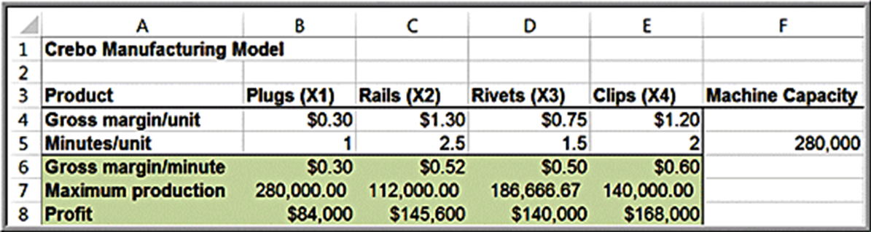
Example 13.11: Solving the Crebo Manufacturing Model
Clips have the highest marginal profit per unit of resource consumed.
Maximum possible production of clips
Profit for maximum production of clips

Slide 50
How Solver Creates Names in Reports
Solver assigns names to:
Target cells
Changing cells
Constraint function cells
Names are formed by concatenating the first cell containing text to the:
Left of the cell and
Above the cell

Slide 51
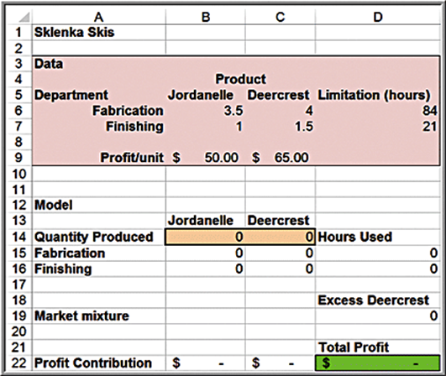
S S C Example
Name assigned to objective function
Cell D22: “Profit Contribution + Total Profit”
Names assigned to decision variables:
Cell B14: “Quantity Produced + Jordanelle”
Cell C14: Quantity Produced + Deercrest”
Names assigned to constraints:
Cell D15: “Fabrication + Hours Used”
Cell D16: “Finishing + Hours Used”
Cell D19: “Market mixture + Excess Deercrest”

Slide 52
Solver Outcomes
Unique optimal solution
There is exactly one solution that will result in the maximum (or minimum) objective.
Alternative (multiple) optimal solutions
The objective is maximized (or minimized) by more than one combination of decision variables, all of which have the same objective function value.
Unbounded solution
The objective can be increased or decreased without bound (i.e., to infinity for a maximization problem or negative infinity for a minimization problem)
Infeasibility
No feasible solution exists

Slide 53
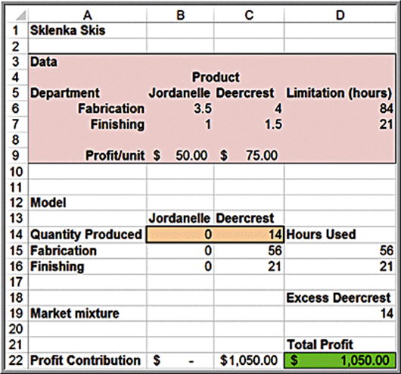
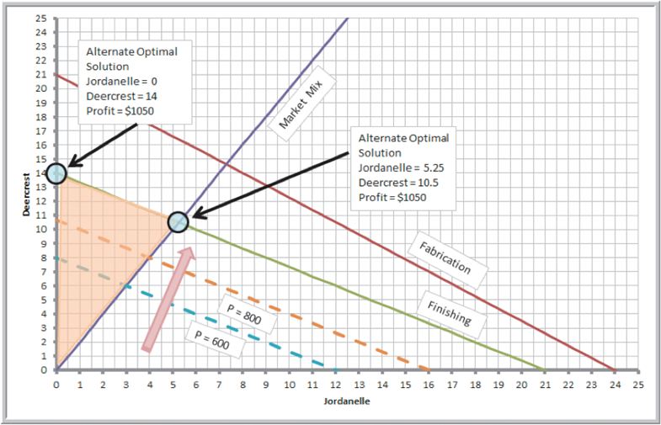
Example 13.12: A Model with Alternative Optimal Solutions
New objective function in the S S C problem:
Max 50 Jordanelle + 75 Deercrest

Slide 54
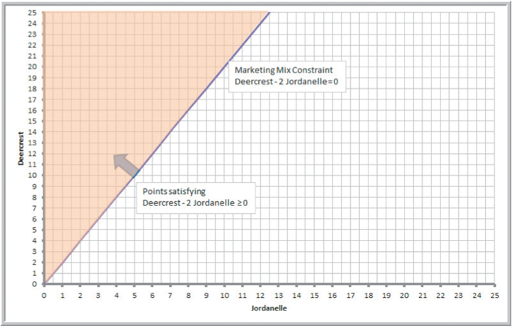
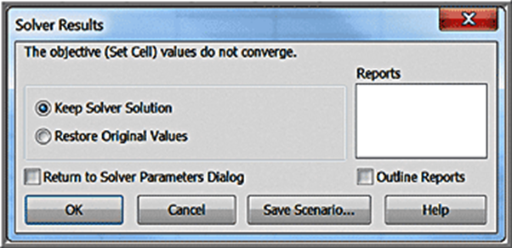
Example 13.13: A Model with an Unbounded Solution
Remove the finishing and fabrication constraints from the Sklenka Ski problem.
Solver message:

Slide 55
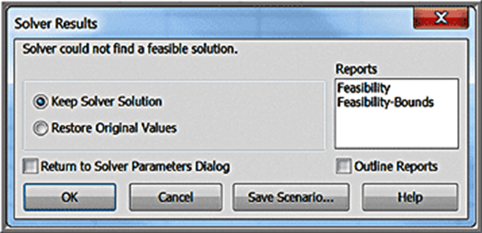
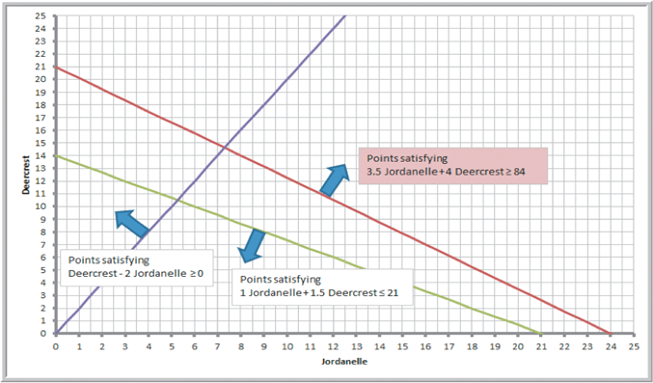
Example 13.14: An Infeasible Model
Suppose, by mistake, the modeler in the Sklenka Ski problem used

Slide 56
Blending Models
Blending problems involve mixing several raw materials that have different characteristics to make a product that meets certain specifications.
Dietary planning, gasoline and oil refining, coal and fertilizer production, and the production of many other types of bulk commodities involve blending.
We typically see proportional constraints in blending models.

Slide 57
Example 13.15: B G Seed Company (1 of 4)
B G Seed Company is developing a new birdseed mix.
Nutritional requirements specify that the mixture contain at least 13% protein, at least 15% fat, and no more than 14% fiber.
B G’s objective is to determine the minimum cost mixture that meets nutritional requirements.
Ingredient | Protein % | Fat % | Fiber % | Cost/lb
Sunflower seeds | 16.9 | 26 | 29 | $0.22
White millet | 12 | 4.1 | 8.3 | $0.19
Kibble corn | 8.5 | 3.8 | 2.7 | $0.10
Oats | 15.4 | 6.3 | 2.4 | $0.10
Cracked corn | 8.5 | 3.8 | 2.7 | $0.07
Wheat | 12 | 1.7 | 2.3 | $0.05
Safflower | 18 | 17.9 | 28.8 | $0.26
Canary grass seed | 11.9 | 4 | 10.9 | $0.11

Slide 58
Example 13.15: B G Seed Company (2 of 4)
Formulating the model
Define
= pounds of ingredient i in 1 pound of mix
Objective function
minimize
Ingredient | Protein % | Fat % | Fiber % | Cost/lb
Sunflower seeds | 16.9 | 26 | 29 | $0.22
White millet | 12 | 4.1 | 8.3 | $0.19
Kibble corn | 8.5 | 3.8 | 2.7 | $0.10
Oats | 15.4 | 6.3 | 2.4 | $0.10
Cracked corn | 8.5 | 3.8 | 2.7 | $0.07
Wheat | 12 | 1.7 | 2.3 | $0.05
Safflower | 18 | 17.9 | 28.8 | $0.26
Canary grass seed | 11.9 | 4 | 10.9 | $0.11

Slide 59
Example 13.15: B G Seed Company (3 of 4)
Protein constraint
Add constraint
Protein constraint simplifies to
Ingredient | Protein % | Fat % | Fiber % | Cost/lb
Sunflower seeds | 16.9 | 26 | 29 | $0.22
White millet | 12 | 4.1 | 8.3 | $0.19
Kibble corn | 8.5 | 3.8 | 2.7 | $0.10
Oats | 15.4 | 6.3 | 2.4 | $0.10
Cracked corn | 8.5 | 3.8 | 2.7 | $0.07
Wheat | 12 | 1.7 | 2.3 | $0.05
Safflower | 18 | 17.9 | 28.8 | $0.26
Canary grass seed | 11.9 | 4 | 10.9 | $0.11
Formulate other nutritional constraints in a similar way.

Slide 60
Example 13.15: B G Seed Company (4 of 4)
Complete model
Minimize:
Mixture:
Protein:
Fat:
Fiber:
Nonnegativity:

Slide 61
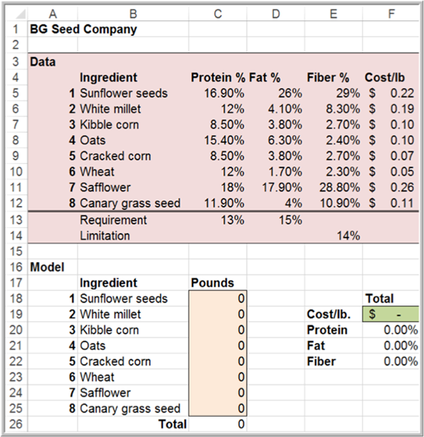
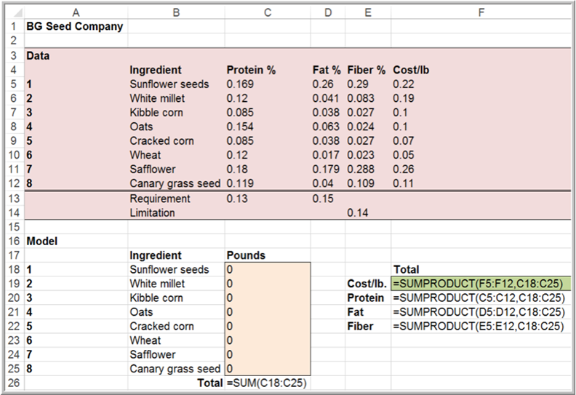
Spreadsheet Implementation of B G Seed Company

Slide 62

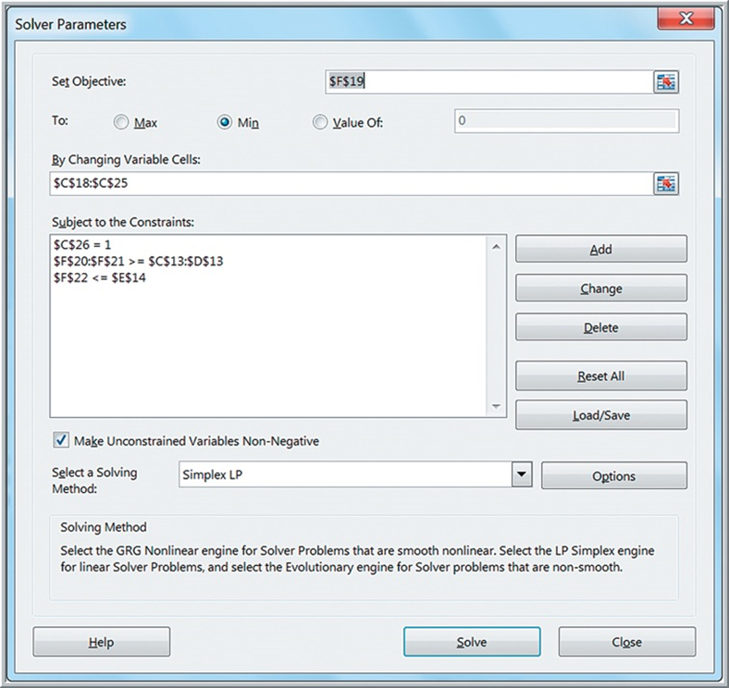
Solver Model for B G Seed Company

Slide 63
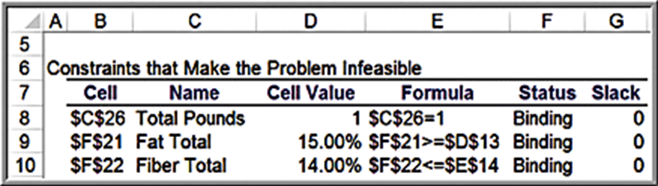
Dealing with Infeasibility
Solver solution shows the model is infeasible!
Solver Feasibility Report
A conflict exists in trying to meet both fat and fiber constraints.
Only sunflower seeds and safflower contain enough fat but they also have a lot of fiber.

Slide 64
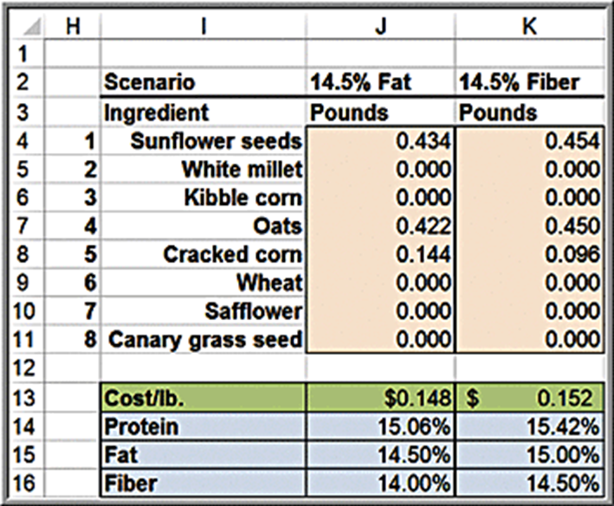
What-If Scenarios
Lower the fat requirement or raise the fiber limitation
1st Scenario:
Fat requirement is lowered from 15% to 14.5%.
2nd Scenario:
Fiber limitation is raised from 14% to 14.5%.
Optimal Cost per pound:
$0.148 if fat requirement lowered
$0.152 if fiber limitation raised

Slide 65
Portfolio Investment Models
Many types of financial investment problems are modeled and solved using linear optimization.
Such portfolio investment models problems have the basic characteristics of blending models.

Slide 66
Example 13.16: Innis Investments (1 of 3)
Innis Investments manages 6 mutual funds. A client wants to invest a $500,000 inheritance. The objective is to minimize risk.
Constraints:
Invest no more than $200,000 in any one fund.
Invest at least $50,000 each in the multinational and balanced funds.
Invest at least 40% combined in the income equity and balanced funds.
Achieve an average return of at least 5%.
Fund | Expected Annual Return | Risk Measure
Innis Low-priced Stock Fund | 8.13% | 10.57
Innis Multinational Fund | 9.02% | 13.22
Innis Mid-cap Stock Fund | 7.56% | 14.02
Innis Mortgage Fund | 3.62% | 2.39
Innis Income Equity Fund | 7.79% | 9.30
Innis Balanced Fund | 4.40% | 7.61

Slide 67
Example 13.16: Innis Investments (2 of 3)
Model Formulation
Define
= dollar amount invested in fund i
The total risk would be measured by the weighted risk of the portfolio, where the weights are the proportion of the total
investment in any fund
minimize total risk
Fund | Expected Annual Return | Risk Measure
Innis Low-priced Stock Fund | 8.13% | 10.57
Innis Multinational Fund | 9.02% | 13.22
Innis Mid-cap Stock Fund | 7.56% | 14.02
Innis Mortgage Fund | 3.62% | 2.39
Innis Income Equity Fund | 7.79% | 9.30
Innis Balanced Fund | 4.40% | 7.61

Slide 68
Example 13.16: Innis Investments (3 of 3)
Constraints
Invest all money:
Achieve required return:
Have at least 40% in income equity and balanced funds:
At least $50,000 in each of multinational and balanced funds:
Restrict each investment to $200,000, and include nonnegativity:

Slide 69
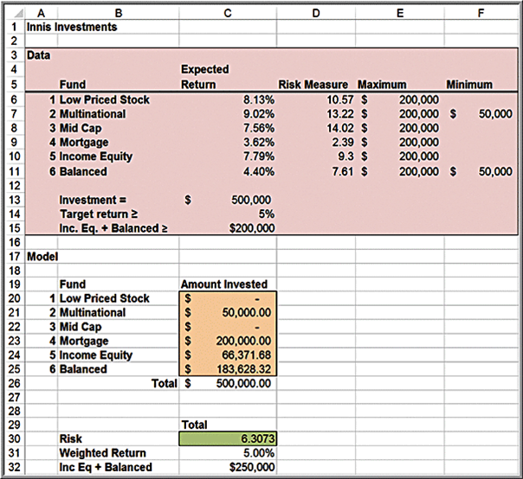
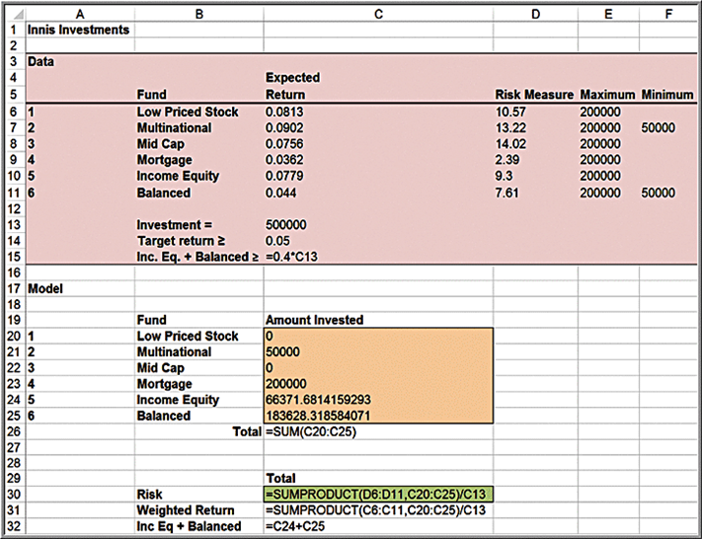
Spreadsheet Implementation for Innis Investments

Slide 70

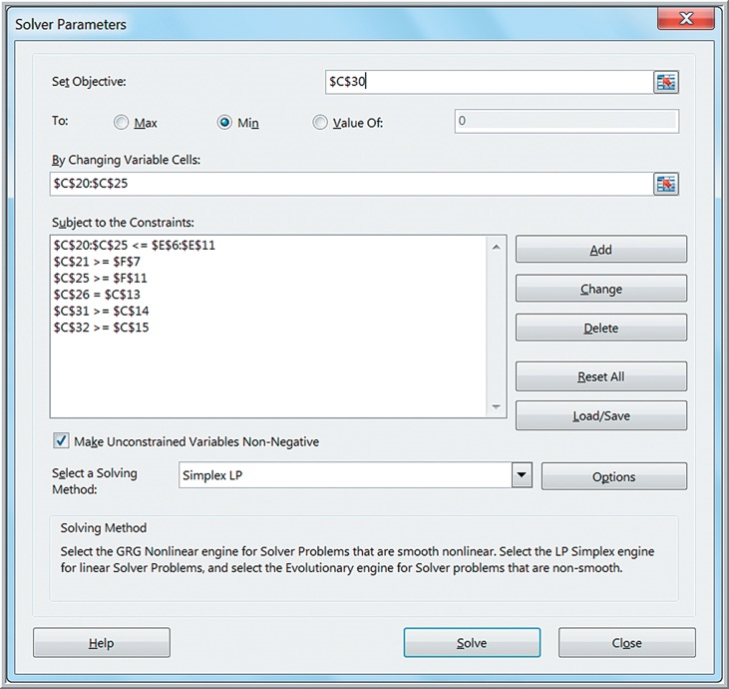
Solver Model for Innis Investments

Slide 71
Scaling Issues in Using Solver
A poorly scaled model is one that computes values of the objective, constraints, or intermediate results that differ by several orders of magnitude.
Poor scaling can cause Solver engines to return messages such as “Solver could not find a feasible solution,” “Solver could not improve the current solution,” or even “The linearity conditions required by this Solver engine are not satisfied,” or it may return results that are suboptimal.
In the Solver options, you can check the box Use Automatic Scaling.
The best way to avoid scaling problems is to carefully choose the “units” implicitly used in your model so that all computed results are within a few orders of magnitude of each other.

Slide 72
Example 13.17: Little Investment Advisors (1 of 4)
Little Investment Advisors is working with a client on determining an optimal portfolio of bond funds. The client has $350,000 to invest and wants to achieve the largest weighted percentage return and keep the weighted risk measure no greater than 5.00.
Bond Portfolio | Expected Return | Risk Measure
Ohio National Bond Portfolio | 6.11% | 4.62
P I M C O Global Bond Unhedged Portfolio | 7.61% | 7.22
Federated High Income Bond Portfolio | 5.29% | 9.75
Morgan Stanley U I F Core Plus Fixed Income Portfolio | 2.79% | 3.95
P I M C O Real Return Portfolio | 7.37% | 6.04
P I M C O Total Return Portfolio | 5.65% | 5.17

Slide 73
Example 13.17: Little Investment Advisors (2 of 4)
Model
Define
be the amount invested in each of the six funds.
Maximize
Bond Portfolio | Expected Return | Risk Measure
Ohio National Bond Portfolio | 6.11% | 4.62
P I M C O Global Bond Unhedged Portfolio | 7.61% | 7.22
Federated High Income Bond Portfolio | 5.29% | 9.75
Morgan Stanley U I F Core Plus Fixed Income Portfolio | 2.79% | 3.95
P I M C O Real Return Portfolio | 7.37% | 6.04
P I M C O Total Return Portfolio | 5.65% | 5.17

Slide 74
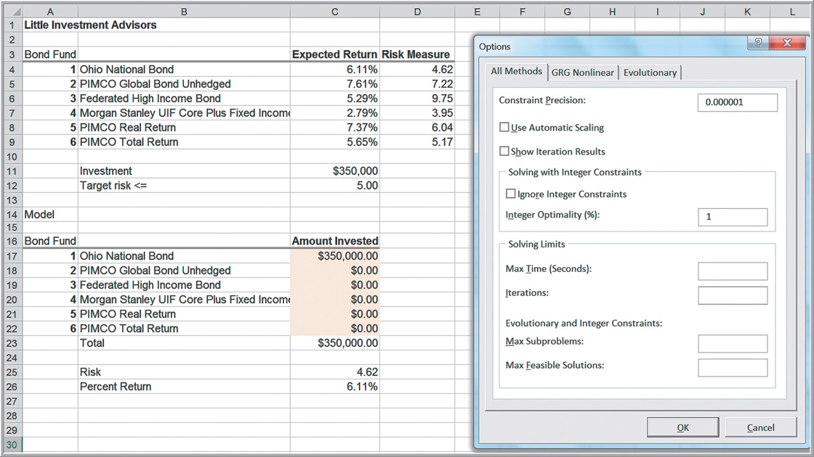
Example 13.17: Little Investment Advisors (3 of 4)
Solver solution without scaling, resulting in an incorrect solution!

Slide 75

Example 13.17: Little Investment Advisors (4 of 4)
Solver solution after scaling the variables

Slide 76
Transportation Models
The transportation problem involves determining how much to ship from a set of sources of supply (factories, warehouses, etc.) to a set of demand locations (warehouses, customers, etc.) at minimum cost.

Slide 77
Example 13.18: General Appliance Corporation (1 of 2)
G A C produces refrigerants at 2 plants and ships to 5 distribution centers.
Plant | Distribution center: Cleveland | Distribution center: Baltimore | Distribution center: Chicago | Distribution center: Phoenix | Distribution center: Capacity
Marietta | $12.60 | $14.35 | $11.52 | $17.58 | 1,200
Minneapolis | $9.75 | $16.26 | $8.11 | $17.92 | 800
Demand | 150 | 350 | 500 | 1,000 | blank
Define the decision variables as:
= amount shipped
from plant i to distribution center j
The objective is to minimize the total cost of shipping between plants and distribution centers.
minimize

Slide 78
Example 13.18: General Appliance Corporation (2 of 2)
Constraints
The amount shipped from each plant cannot exceed its capacity.
Demand at each distribution center is met.
Nonnegativity

Slide 79
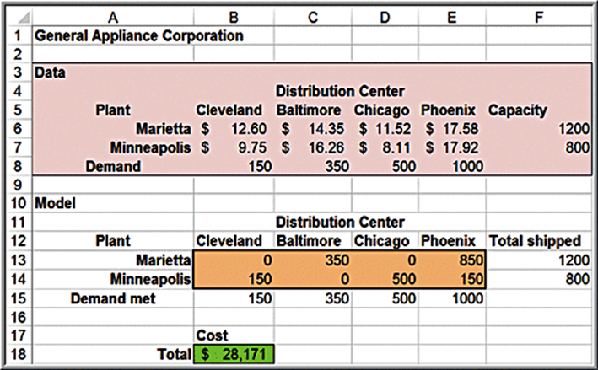
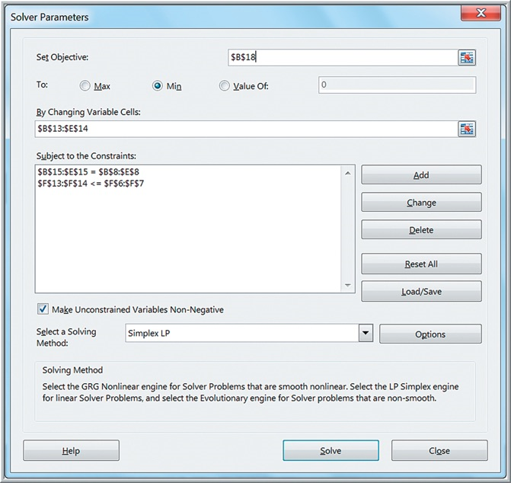
G A C Spreadsheet Implementation and Solver Model

Slide 80
Multiperiod Production Planning Models
The basic decisions are how much to produce in each time period to meet anticipated demand over each period.
Although it might seem obvious to simply produce to the anticipated level of sales, it may be advantageous to produce more than needed in earlier time periods when production costs may be lower and store the excess production as inventory for use in later time periods, thereby letting lower production costs offset the costs of holding the inventory.

Slide 81
Example 13.19: K&L Designs (1 of 5)
K&L Designs makes hand-painted jewelry boxes.
Forecasted sales are 150 in autumn, 400 in winter, and 50 in spring.
Unpainted boxes cost $20 and each box takes 2 hours to complete.
The cost of capital is 6% per quarter.
Holding cost per item = 0.06(20) = $1.20/quarter
Labor rates are $5.50, $7.00, and $6.25 per hour during autumn, winter, and spring, respectively.
Minimize the combined cost of production and inventory holding costs.

Slide 82
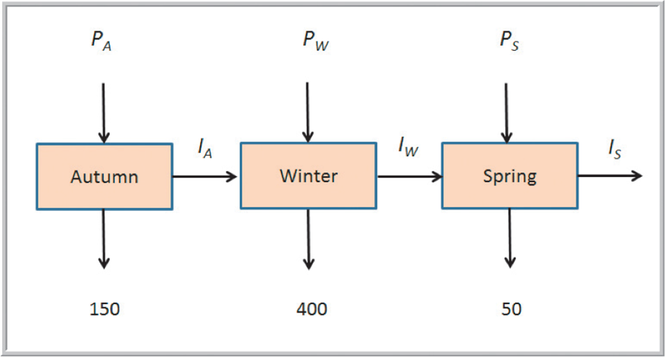
Example 13.19: K&L Designs (2 of 5)
Decision variables
= amount to produce in quarter i (1 = autumn; 2 =
winter; 3 = spring)
= inventory at the end of quarter i

Slide 83
Example 13.19: K&L Designs (3 of 5)
Objective function
The production cost per unit is computed by multiplying the labor rate by the number of hours required to produce one.
Thus, the unit cost in the autumn is
in the
winter,
and in the spring,
minimize

Slide 84
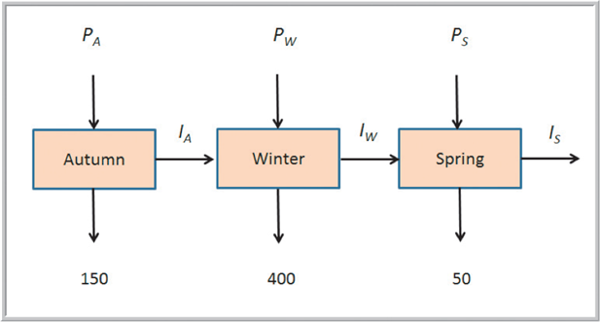
Example 13.19: K&L Designs (4 of 5)
Constraints
Satisfy demand using production in a quarter and the inventory held from the previous time quarter. Any amount in excess of the demand is held to the next quarter.
Therefore, the constraints take the form of inventory balance equations:
production + inventory from the previous quarter = demand + inventory held to the next quarter

Slide 85
Example 13.19: K&L Designs (5 of 5)
Complete model
minimize
subject to

Slide 86
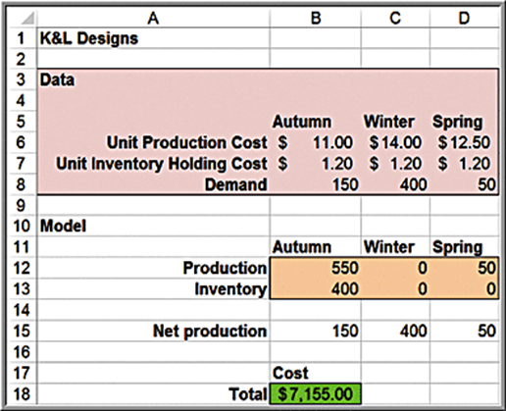
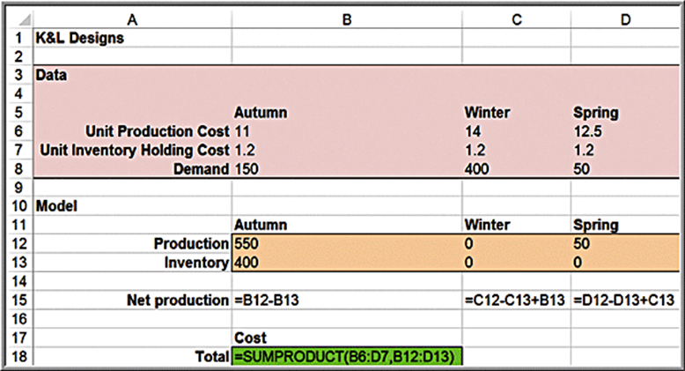
Spreadsheet Implementation for K&L Designs

Slide 87
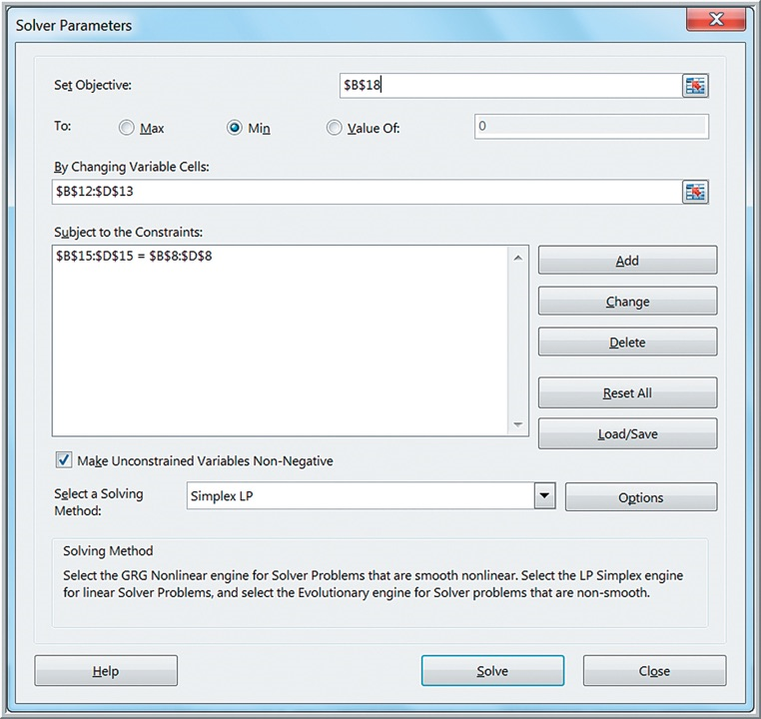

Solver Model for K&L Designs

Slide 88
Example 13.20: An Alternative Optimization Model for K&L Designs
To ensure that demand is satisfied, we can set the cumulative production in each quarter to be at least as great as the cumulative demand.
This eliminates inventory variables.
minimize

Slide 89
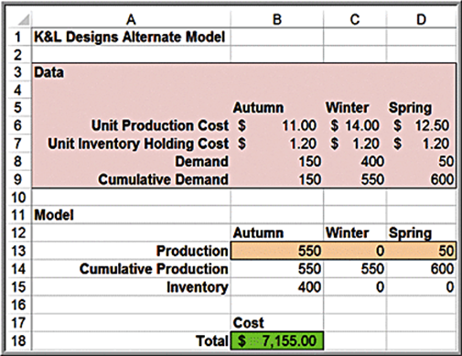
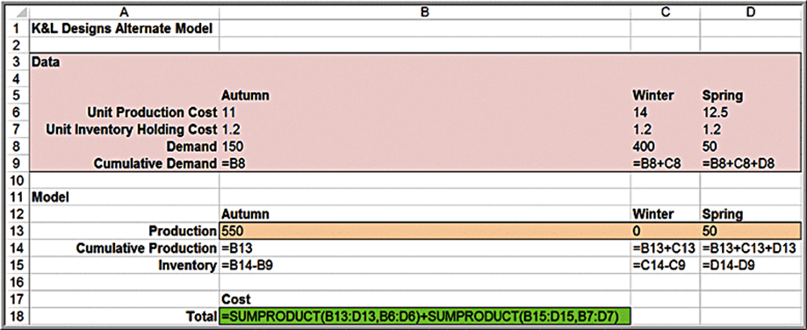
Alternative Spreadsheet Model

Slide 90

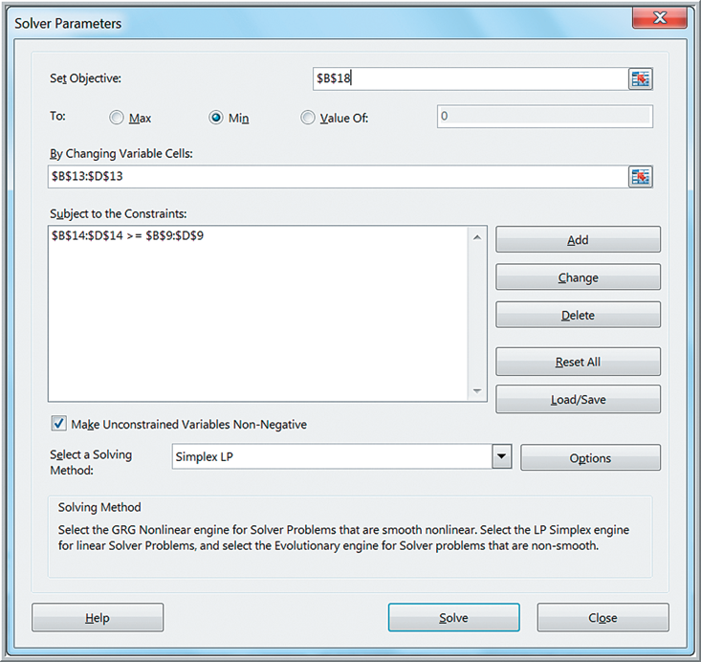
Alternative Solver Model

Slide 91
Multiperiod Financial Planning Models
Financial planning often occurs over an extended time horizon.
Financial planning models have similar characteristics to multiperiod production planning and can be formulated as multiperiod optimization models.

Slide 92
Example 13.21: D.A. Branch & Sons (1 of 3)
The company’s financial manager needs to ensure that funds are available to pay expenses yet needs to maximize investment income.
Three short-term investments are being considered:
1-month C D paying 0.25%
3-month C D paying 1.00% at maturity
6-month C D paying 2.30% at maturity
The net expenditures for the next 6 months are forecast as $50,000, ($12,000), $23,000, ($20,000), $41,000, and ($13,000)
A cash balance of $10,000 must be maintained. Currently the cash balance is $200,000.

Slide 93
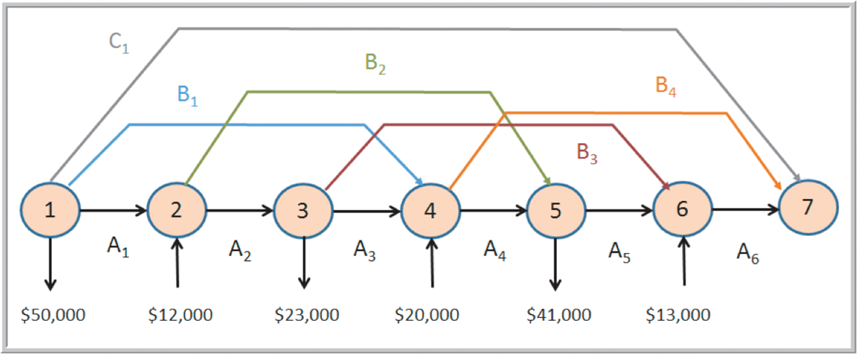
Example 13.21: D.A. Branch &Sons (2 of 3)
Model development
= amount ($) to invest in a 1-month C D at the start of month i
= amount ($) to invest in a 3-month C D at the start of month i
= amount ($) to invest in a 6-month C D at the start of month i

Slide 94
Example 13.21: D.A. Branch & Sons (3 of 3)
Optimization model
maximize
subject to

Slide 95
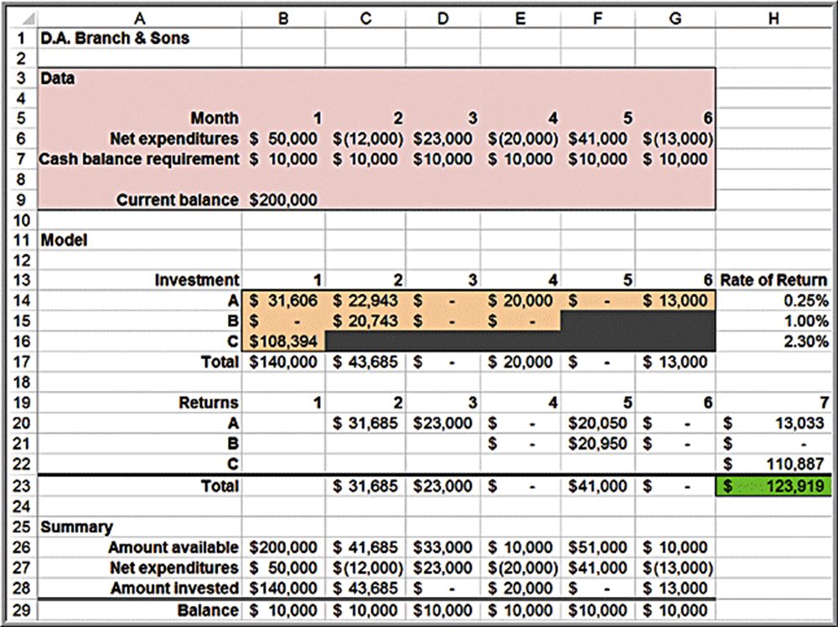
Spreadsheet Model for D.A. Branch & Sons

Slide 96
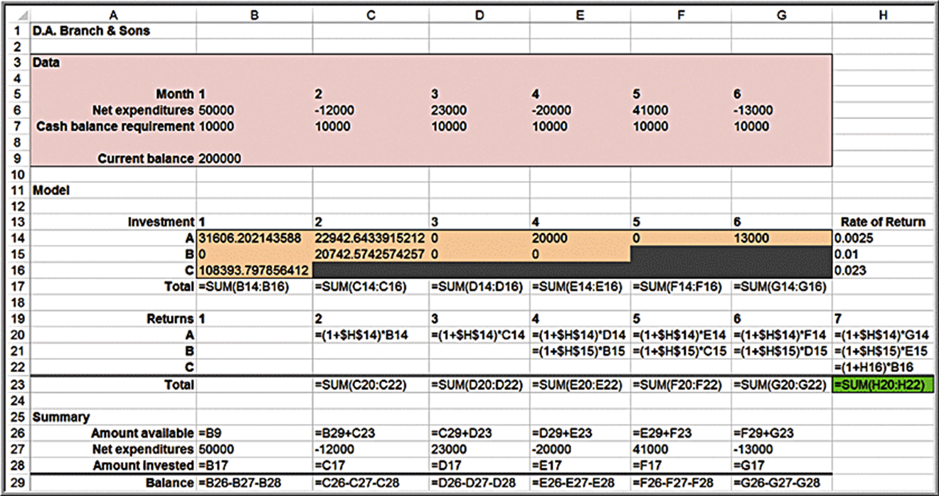
Spreadsheet Model Formulas for D.A. Branch & Sons

Slide 97
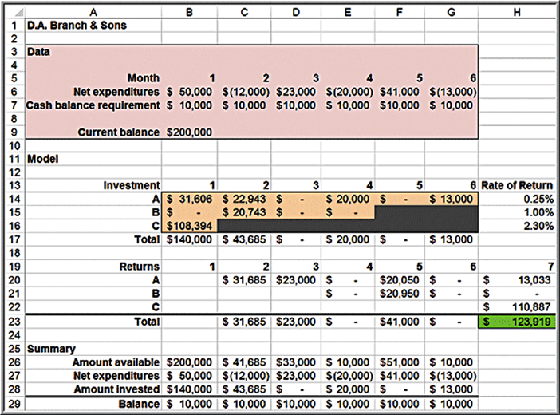
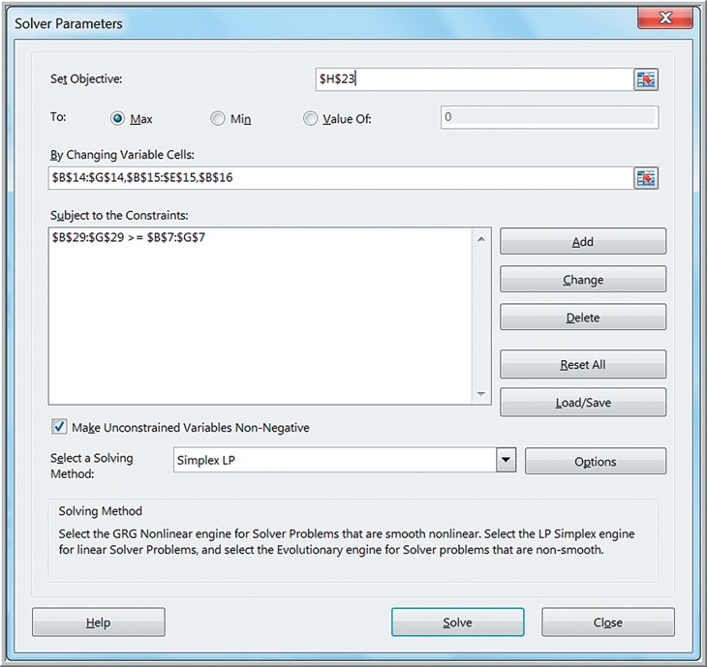
Solver Model for D.A. Branch & Sons

